Slide 1


DENSITY-BASED TRAFFIC CONTROL SYSTEM
Student investigators: Project Guide :
Ahammedunny Navas Prof.Belma Joseph
Arjun R Assistant Professor
Abhinand Dinesh ECE Department
Ashil Siby
CLASS:S7LA

Slide 2
INTRODUCTION
Focuses on switching the traffic light based on the vehicle density.
Uses the image processing technique to monitor the vehicles.
Implementing separate traffic control systems for day and night.
Developing traffic control mechanism on rainy days

Slide 3
PROPOSED TOOLS FOR THE PROJECT
SOFTWARE TOOLS
PYTHON
OPENCV
KERAS
TENSORFLOW
ALTIUM
STM32 CUBE IDE
PROTEUS

Slide 4
PROPOSED TOOLS FOR THE PROJECT
HARDWARE COMPONENTS
RASPBERRY PI
LDR SENSOR
SEVEN SEGMENT
MICRO CONTROLLER (STM32F301)
RAIN SENSOR
CAMERA MODULE

Slide 5
BLOCK DIAGRAM
Power Supply
Camera
Raspberry Pi
ML Algorithm
STM32F103
Power Supply
Traffic Light
Timer

Slide 6
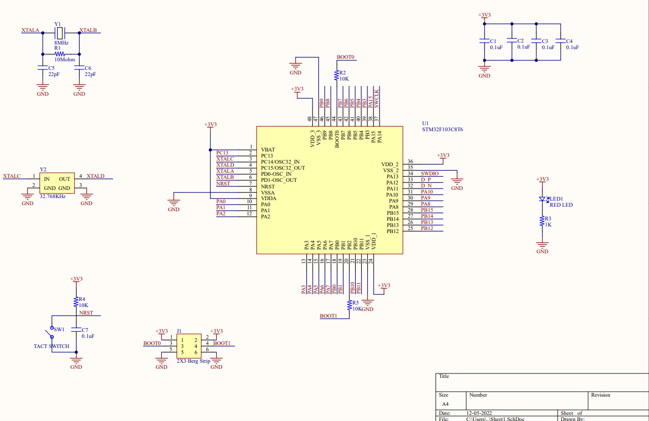
SCHEMATIC DIAGRAM

Slide 7
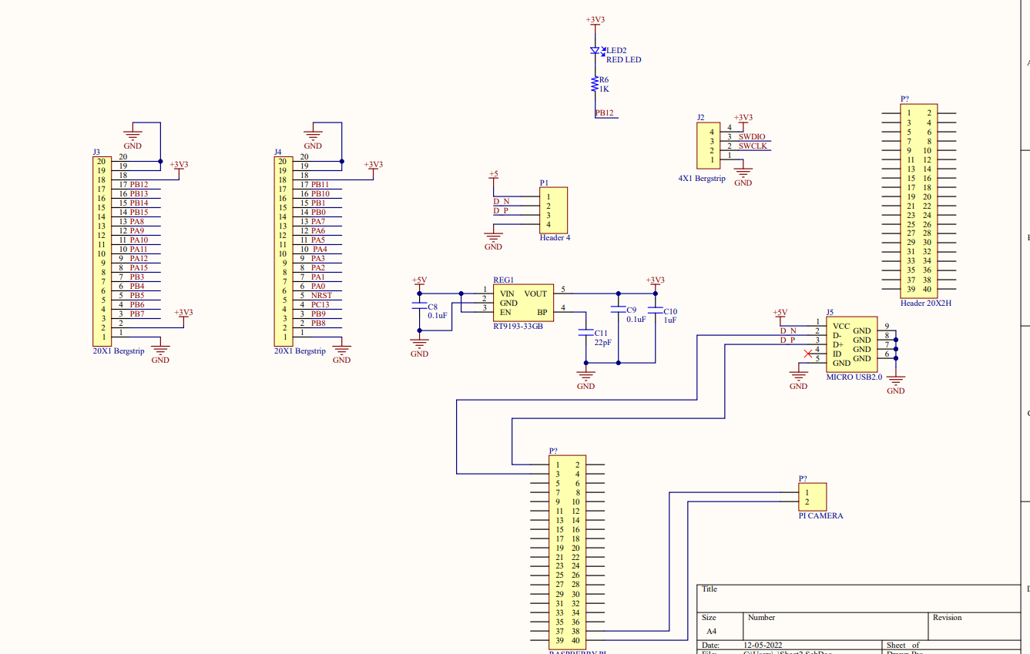

Slide 8
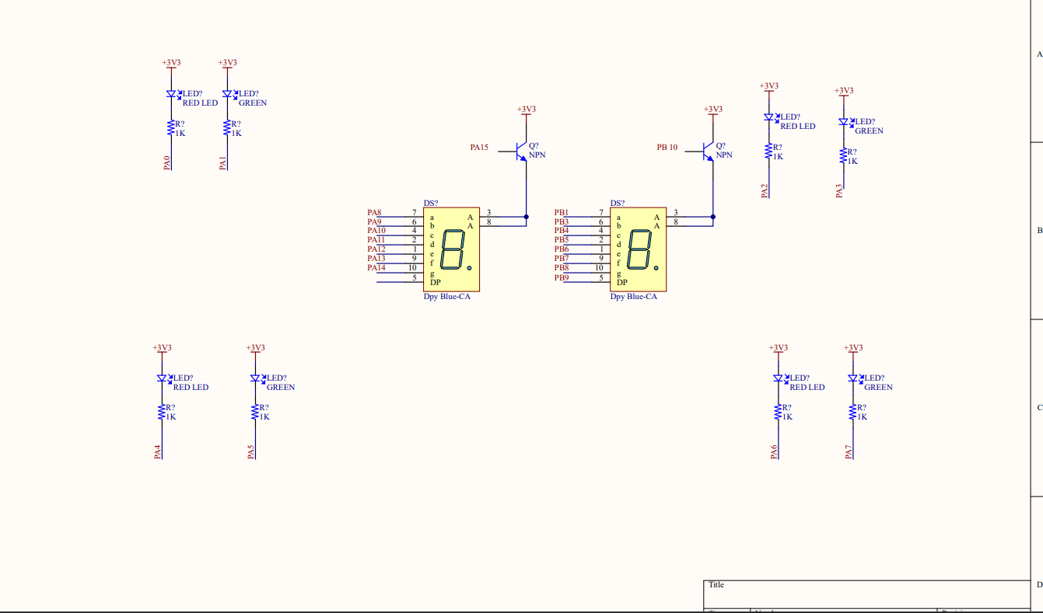

Slide 9

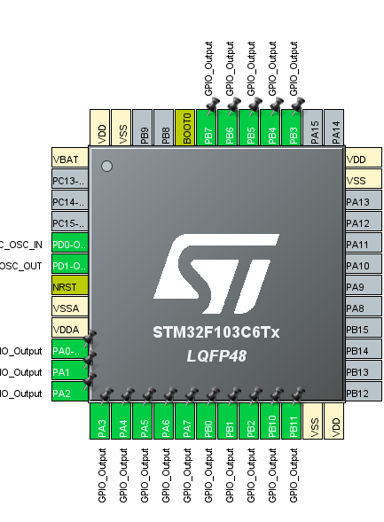
STM32F103C6 PINOUT DIAGRAM

Slide 10
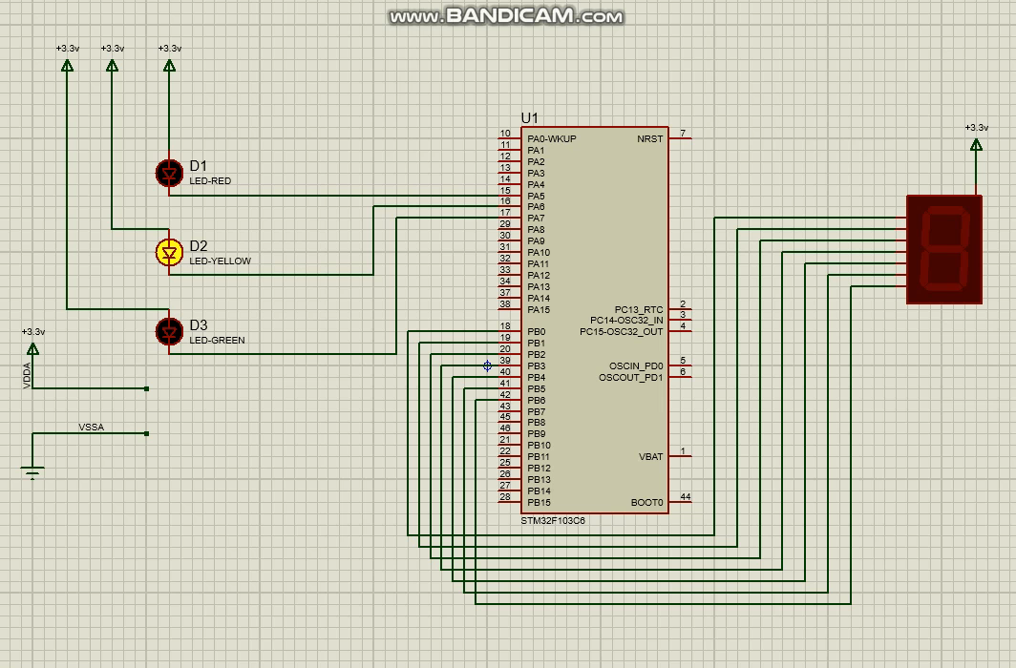
SIMULATION USING STM32F103

Slide 11
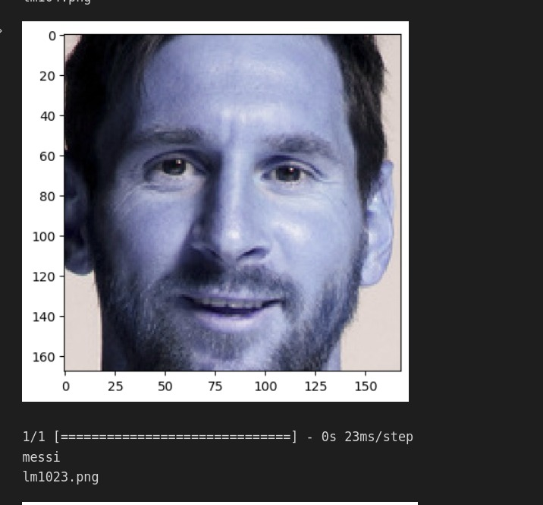
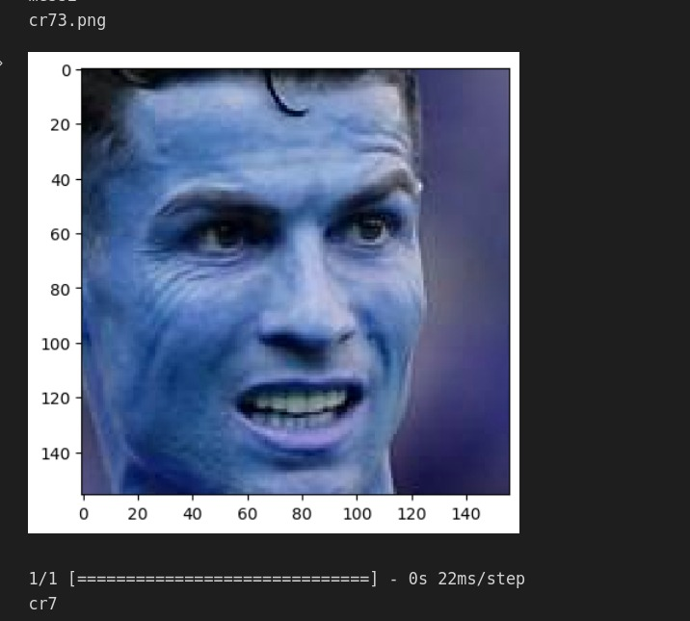
CR7 VS MESSI IMAGE CLASSIFICATION

Slide 12
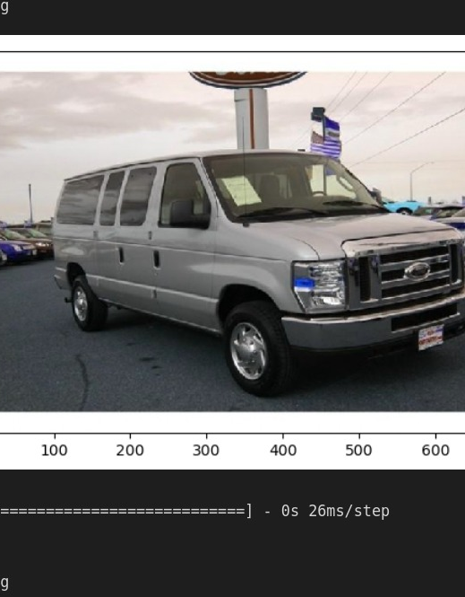
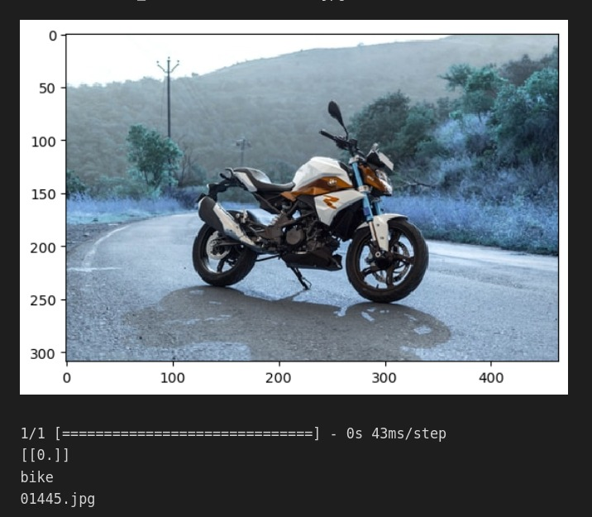
CAR VS BIKE IMAGE CLASSIFICATION

Slide 13
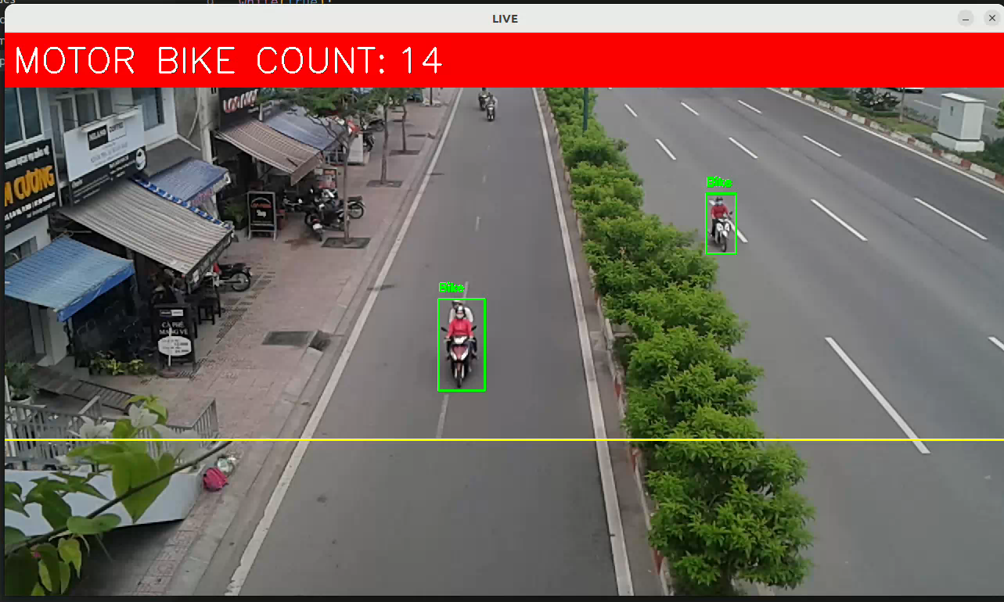
VEHICLE DETECTION AND COUNT

Slide 14
THANK YOU

